Slide 1
Types of Software Testing
2025
Poornima

Slide 2
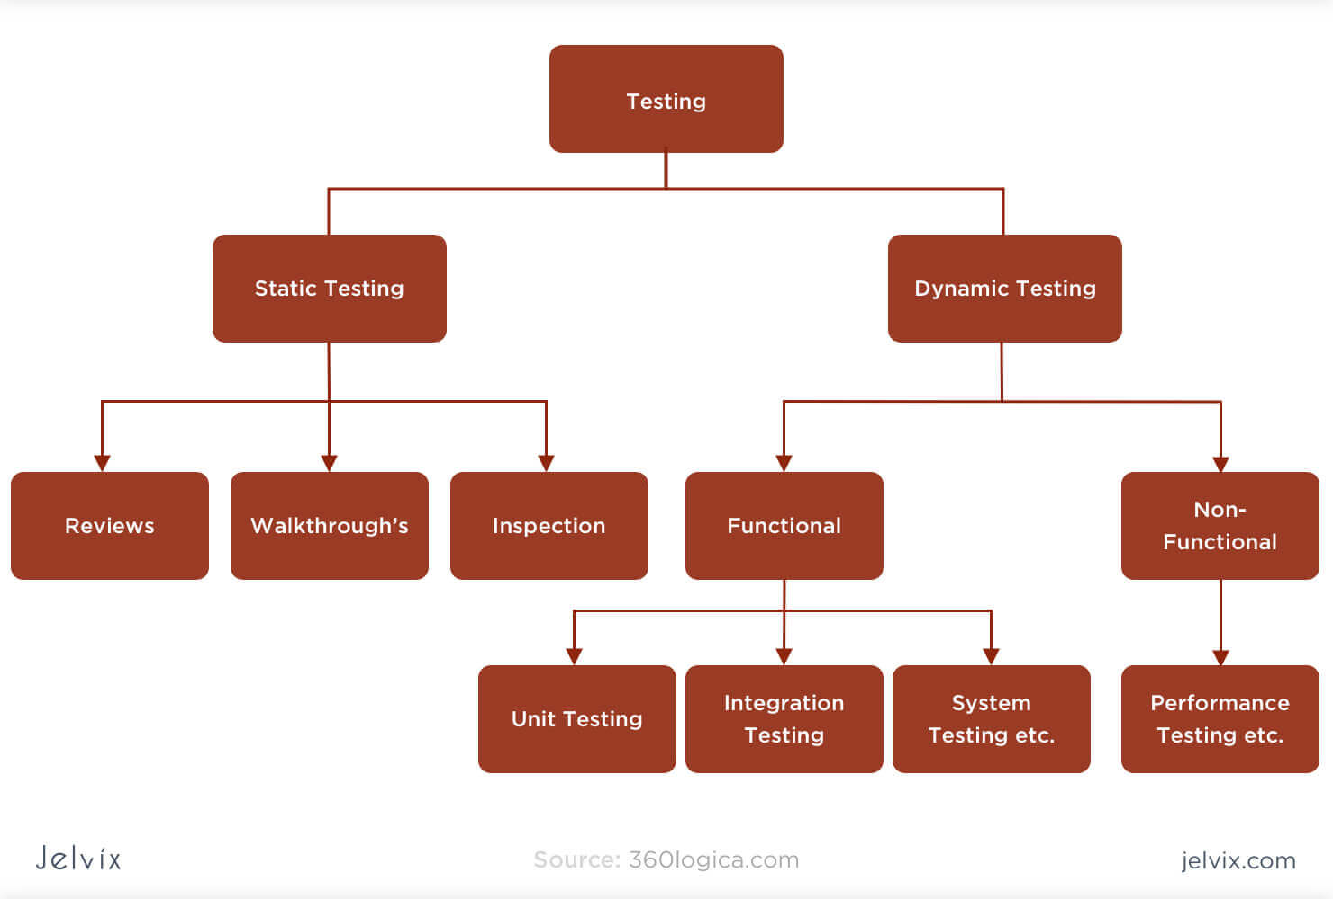
Types of Testing
STATIC TESTING
Static Testing also known as Verification testing or Non-execution testing is a type of Software Testing method.
Static testing performed in the early stage of development to avoid errors as it is easier to find sources of failures, and it can be fixed easily.
It enhances maintainability and ultimately saves time and money in the long run.

Slide 3
Static Testing
OBJECTIVES OF STATIC TESTING
Decreases Flaws
Saves Time
Easy Bug Fixing
Quality Improvement
Cost Efficiency

Slide 4
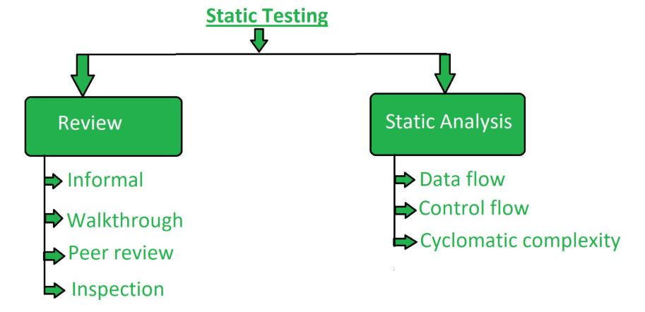
Static Testing
STATIC TESTING TECHNIQUES
Tools
BrowserStack Code Quality Tool
Checkstyle
SourceMeter
Soot
Lint
SonarQube
PMD
FindBugs

Slide 5
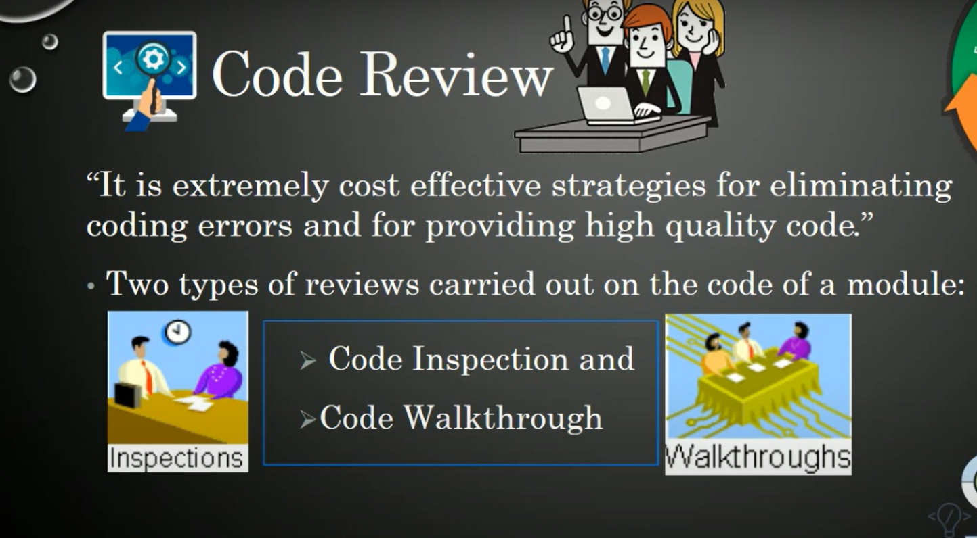
Review, Walkthrough & Inspection

Slide 6
Review, Walkthrough & Inspection
Code Walkthrough
Code Inspection
Code Walkthrough is an informal code analysis technique in which a module is taken up for review after the module has been coded, complied successfully.
Main motive is to identify the error.
The aim of code inspection is to check for the presence of some common type of errors and to check the coding standards.
Programming errors

Slide 7
Dynamic Testing
DYNAMIC TESTING
Dynamic testing refers to analyzing code’s dynamic behavior in the software.
The main purpose of dynamic testing is to validate the software and ensure it works properly without any faults .
Dynamic testing is a software testing approach where the runtime behavior of the software is assessed.
Unlike static testing, dynamic testing compiles and executes the code, providing input to the software and validating the resulting output to ensure proper functionality.

Slide 8
Dynamic Testing
OBJECTIVES OF DYNAMIC TESTING
TYPES OF DYNAMIC TESTING
Functional Testing
Unit Testing
Integration Testing
System Testing
User Acceptance Testing (UAT)
Non Functional Testing
Performance Testing
Load Testing
Security Testing
Usability Testing
Identify Defects
Verify Functionality
Validate Output
Improve Software Quality
Evaluate Performance
Test Compatibility

Slide 9
Functional Testing
Functional testing is a type of software testing that verifies that each function of the software application behaves according to the specific requirements and meets expectations in different conditions.

Slide 10
Functional Testing
Helps in ensuring the software fulfills user needs
Helps identify functional issues early on
Enhances application quality and user experience
Ensures application compatibility across different platforms
Verifies user workflows and interactions
Benefits of Functional Testing

Slide 11
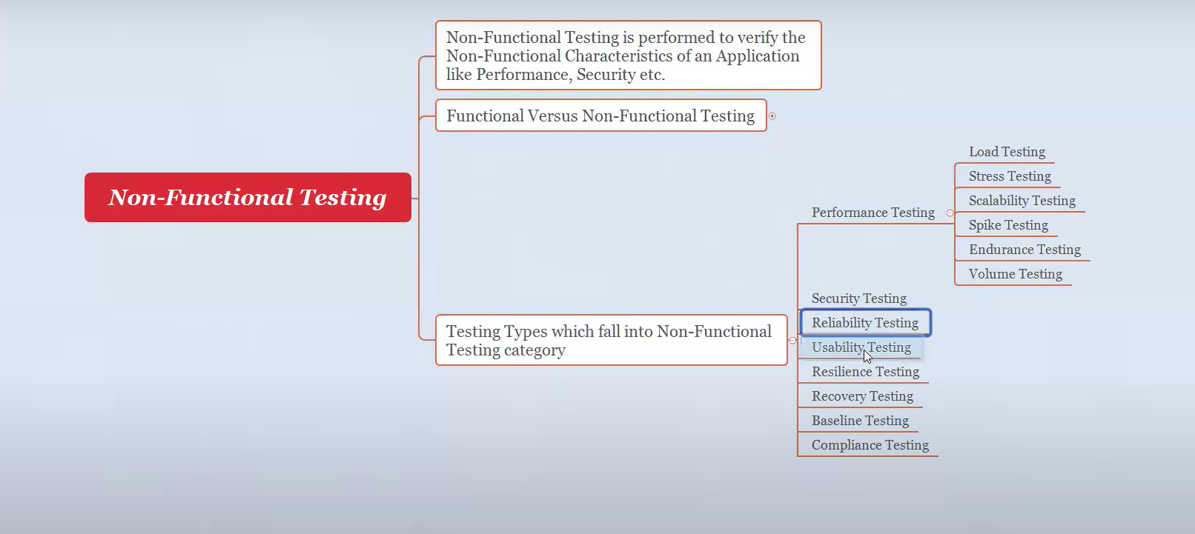
Non Functional Testing

Slide 12
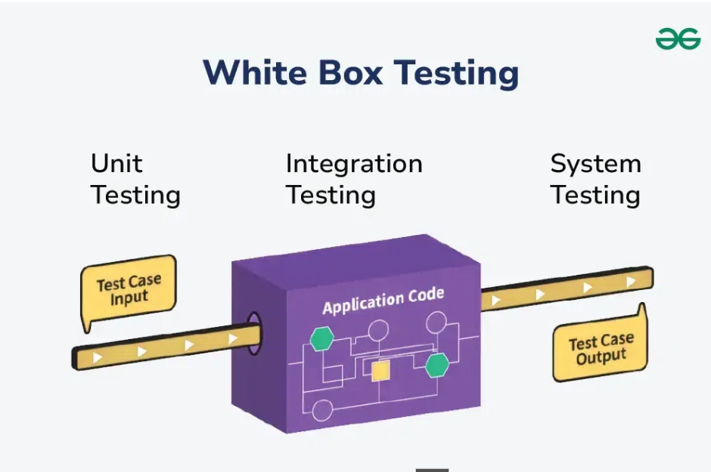
White Box Testing
White box testing mandates the coding knowledge of a tester because it needs to test internal coding implementation and algorithms for the system.
you have to execute a programming line-by-line to find whether there are errors in the line
Input and output are already known for this testing.

Slide 13
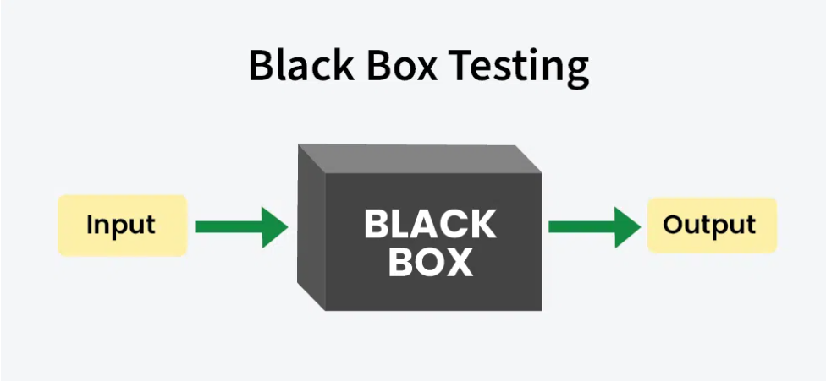
Black Box Testing
In Black Box testing test, engineers have to test the software as per the requirements and specifications.
They don’t need to know about the internal implementation or coding of the software. So, programming knowledge is not necessary for this testing.
Black box testing is performed after white box testing.

Slide 14
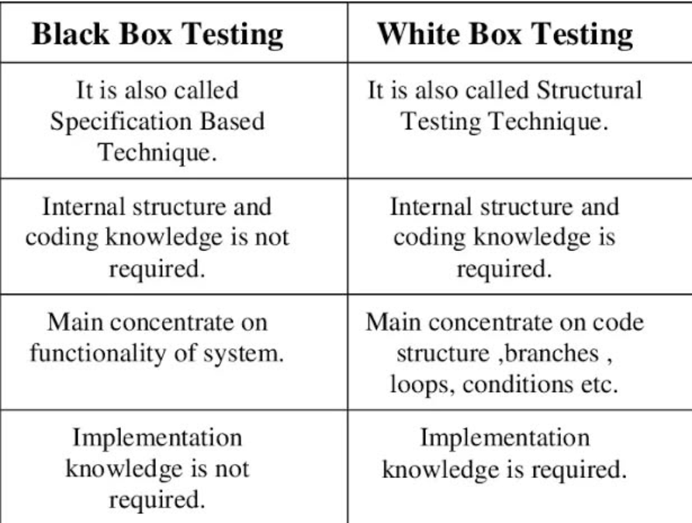
Black Box & White Box Testing

Slide 15
Levels of Testing
Testing occurs at different levels in the software development lifecycle:
Unit Testing: Individual components/modules (done by developers). Ensuring correct behavior at the smallest level
Integration Testing: Combination of modules working together. ensures that data flows correctly between modules and that they communicate seamlessly.
System Testing: The complete system as a whole.
Acceptance Testing: Ensures the software meets business needs. Getting final approval from the customer.
1
Unit Testing
4
Acceptance Testing
2
Integration
Testing
3
System Testing

Slide 16
Levels of Testing – System Testing
1
Unit Testing
Full end-to-end testing of the software performed on the complete system.
Verifying both functional and non-functional requirements.
Testing the software's behavior in real-world conditions.
Types of system testing:
Functional Testing
Non Functional Testing
UI Testing
Usability Testing
4
Acceptance Testing
2
Integration
Testing
3
System Testing

Slide 17
GUI Testing
1
Unit Testing
GUI testing, or Graphical User Interface testing, is a type of software testing that focuses on validating the visual elements and user interactions of an application's interface.
It ensures that all on-screen elements, such as buttons, menus, icons, text fields, and dialogs, function correctly and appear as expected across various devices and screen resolutions.
4
Acceptance Testing
2
Integration
Testing
3
System Testing

Slide 18
Usability Testing
1
Unit Testing
Usability testing is a method used to evaluate how easy a product or system is to use by observing real users as they interact with it.
It focuses on identifying pain points, areas of confusion, and aspects that hinder user satisfaction and efficiency, ultimately leading to improvements in the product's design and functionality.
4
Acceptance Testing
2
Integration
Testing
3
System Testing

Slide 19
Regression Testing
1
Unit Testing
Regression testing is a type of software testing that ensures previously developed and tested software still works correctly after changes, updates, or bug fixes.
It involves re-running existing test cases to verify that new modifications haven't introduced any unintended issues or broken existing functionality.
This helps maintain the overall quality and stability of the software.
4
Acceptance Testing
2
Integration
Testing
3
System Testing

Slide 20
Retesting
1
Unit Testing
Retesting is testing of a particular bug after it has been fixed.
Usually tester raises the bug when they find it while testing the product or its component. This bug is assigned to a developer and he fixes it.
Post fixing the bug is assigned to the tester for its verification. This testing is known as retesting.
4
Acceptance Testing
2
Integration
Testing
3
System Testing

Slide 21
Exploratory Testing
1
Unit Testing
Exploratory testing is an approach to software testing that emphasizes simultaneous learning, test design, and test execution.
Unlike traditional scripted testing, where testers follow predefined test cases, exploratory testing involves testers actively exploring the software, making spontaneous decisions about what to test, and designing tests on the fly as they learn about the system's behavior.
4
Acceptance Testing
3
System Testing

Slide 22
Ad-hoc Testing
1
Unit Testing
Ad-hoc testing is an informal, unstructured software testing approach where testers explore the application without predefined test cases or a formal plan
4
Acceptance Testing
2
Integration
Testing
3
System Testing

Slide 23
Monkey Testing
1
Unit Testing
Monkey testing is a software testing technique where the tester enters random inputs and performs random actions on the application without following any predefined test cases or scenarios
4
Acceptance Testing
2
Integration
Testing
3
System Testing

Slide 24
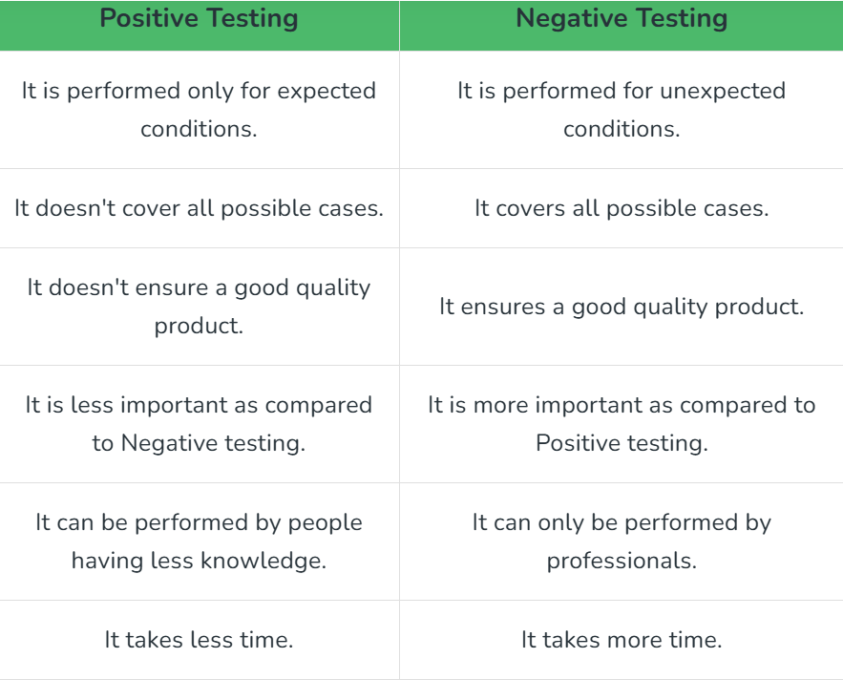
Positive & Negative Testing
1
Unit Testing
4
Acceptance Testing
2
Integration
Testing
3
System Testing

Slide 25
End to End Testing
1
Unit Testing
End-to-end (E2E) testing is a software testing methodology that validates an application's workflow from start to finish, simulating real-world user scenarios to ensure all integrated components function correctly
4
Acceptance Testing
2
Integration
Testing
3
System Testing

Slide 26
Localization & Globalization/Internationalization(I18N) testing
1
Unit Testing
Globalization Testing
Localization Testing
Globalization testing checks the application supports different languages.
It tests the different currency formats, mobile number formats and address formats are supported by the application.
Localization testing checks the application supports the specific language
It tests the specific currency format, mobile number format and address format is working properly or not language.
4
Acceptance Testing
2
Integration
Testing
3
System Testing

Slide 27
QA, QC and QE
Quality Assurance- Quality Assurance (QA) prevents software defects or minimizes the number of defects in software before delivery by making sure that proper methods and processes are followed during the software development process.
Quality Control: It identifies and fixes the defects or errors that exist after development.
Quality Engineer: This is a more modern and comprehensive approach that integrates quality into every stage of the development lifecycle, emphasizing automation and a "shift-left" methodology.

Slide 28
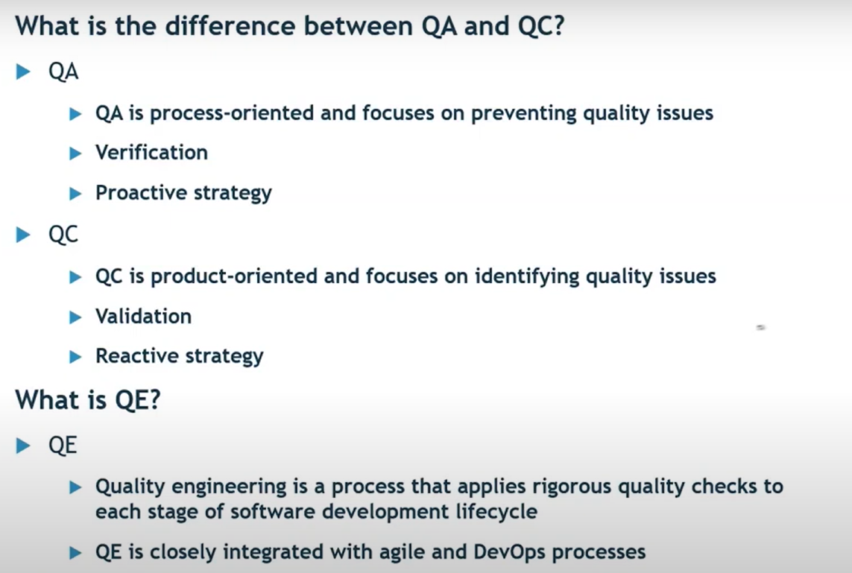
QA, QC and QE

